Slide 1
THC Hydra
Ammar Khan
Moazzan Sabir

Slide 2
Tool introduction
Hydra is a parallelized login cracker which supports numerous protocols to attack.
This tool makes it possible for researchers and security consultants to show how easy it would be to gain unauthorized access to a system remotely.

Slide 3
Supported protocols
Login forms
FTP
SMB
POP3
IMAP
VNC
SSH

Slide 4
Testing purpose
Router/modems still have their portals secured via HTTP BasicAuth protocol locked with a string of length 5-6 words generated by RE of alpha numeric words.
It is really easy to break this combination as it takes max time of ~27 hours to exhaust every possible combination via brute force and due to database breaches, a lot of combinations are already leaked, which could be cracked via dictionary attacks.
Each router/modem has username admin, which is a big blunder itself.

Slide 5
Test Setup
Dummy Flask web server protected via HTTP Basic Auth to mimic a router.
Fedora OS used to perform Dictionary attack via THC Hydra.
Centos OS used to perform Brute-Force attack via THC Hydra.
Password length reduced to 3 to complete attack early, but the RE is still alpha-numeric.

Slide 6
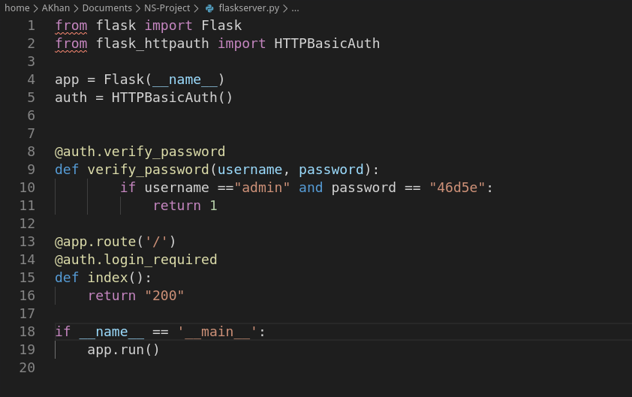
Flask Server code

Slide 7
Dictionary Attack
A dictionary attack is a method of breaking into a password-protected computer or server by systematically entering every word in a dictionary as a password.
Dictionary for attack purpose is borrowed from GitHub.
Command Used on THC Hydra: ”hydra -f -l admin -P passwords.txt -s 5000 -f 127.0.0.1 http-get”

Slide 8
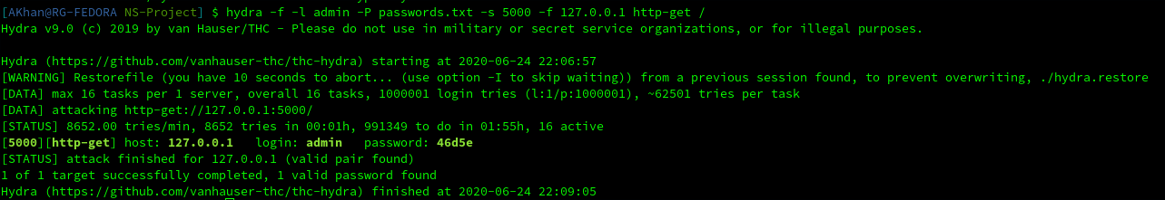
Results
Attack was started on 2020-06-24 22:06:57 and it completed on 2020-06-24 22:09:05, which is roughly 3 minutes.

Slide 9
Brute-force attack
A brute-force attack consists of an attacker submitting many passwords or passphrases with the hope of eventually guessing correctly.
RE used: 3:3:’a1’
THC Hydra Command: “hydra -l admin -x 3:3:’a1’ -s 5000 -f 127.0.0.1 http-get /”

Slide 10
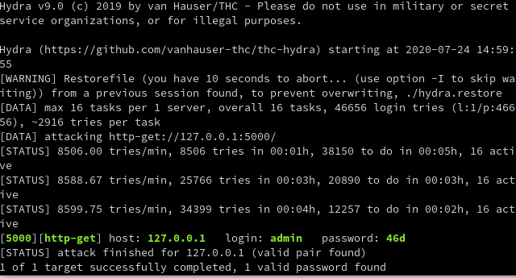
Results
Attack completed in roughly 4 minutes.

Slide 11
Conclusion
String length should be increased to 16.
RE should include special characters and upper case alphabets as well.
Usernames must also be randomized using same criteria.
A limit on max attempts should be applied.
Block IP addresses of those which exceed attempt limits.
By default, login page should be only accessible from router’s own subnet.

